Slide 1
Teachers And Counselors: Then & Now
Summary Report
April, 2011

Slide 2
Table Of Contents
Page
2
5
12
Research Design
Teachers And Counselors Results
Awareness And Image

Slide 3
Research Design: Teachers & Counselors
Objective
To understand the perceptions and attitudes of Kentucky public high school teachers and counselors of junior and senior high school students regarding Kentucky Community and Technical Colleges.
Methodology
Online Survey
Multi-stage design
Interviewers contacted high school principals throughout the state of Kentucky to ask their permission to send their teachers and counselors of juniors and seniors an invitation and link to do an online survey about postsecondary education.
A spreadsheet was sent to all of those who agreed asking them to provide the email addresses of all teachers and counselors of juniors and seniors in their school.
The teachers and counselors were sent the invitation and link to the Horizon Group International website in order to complete the interview.

Slide 4
Research Design: Teachers & Counselors
Fieldwork
Recruit principals and collect email addresses: October – December 2010
Teachers and Counselors complete survey online: November 2010 – January 2011
Sample Size
Completed Interviews = 318
Reporting/Graphics
The percents shown on the graphs are based on those who had a response to the question.
A on the graphs indicates a discernibly statistical difference from the corresponding segment at the 90 percent confidence level.

Slide 5
Research Design: Teachers & Counselors
Methodology By Stage
A list was purchased of all public high schools in Kentucky.
Those included regular high schools, vocational and alternative schools.
The number of regular public high schools were 221.
An additional list of area technology centers (ATC) was obtained.
There were 54 ATC.
The lists were combined and a census was attempted.
Total number of schools attempted were 275.
Of those, 258 were contacted.
Of those, 249 agreed to send email lists.
Of those, 108 Sent list (after multiple reminders)
Interviews were completed with 318 teachers/counselors
representing 90 schools.
Respondents worked in multiple areas.
Teachers of Juniors: 73%
Teachers of Seniors: 71%
Counselors: 17%
ATC Teachers/Counselors: 19%
 | N= | % of Total
Total lists | 275 | 100%
Contacted | 258 | 94%
Agreed to send list | 249 | 91%
Actually sent list | 108* | 39%
Schools represented in completed interviews | 90 | 33%
*The lists sent from the schools included 1,666 emails.

Slide 6
Teachers and Counselors Results

Slide 7
Teacher Perception of Student “Fit”
Teachers and counselors hypothetically divided their classes up much the way they did five years ago. They picked about one third to go to a four-year college and a similar number to go to a community or technical college. They still believed that about one in seven should go right to work or possibly the military and forego postsecondary education.
Please start by thinking about a typical group of 10 students that you teach or counsel. Thinking of those 10 students and the variety of postsecondary options available, please fill in the number of those students that you think would have the best fit in each of four options.
Type of School |  | Best Fit for Students
 |  | 2006 (%)* | 2011 (%)*
Four-year College |  | 37 | 35
Community or Technical College |  | 32 | 32
Private Business or Trade School |  | 16 | 19
No Post- secondary Schooling |  | 15 | 14
Total |  | 100 | 100
n = |  | (196) | (318)
* Based on the mean of 4 different questions.

Slide 8
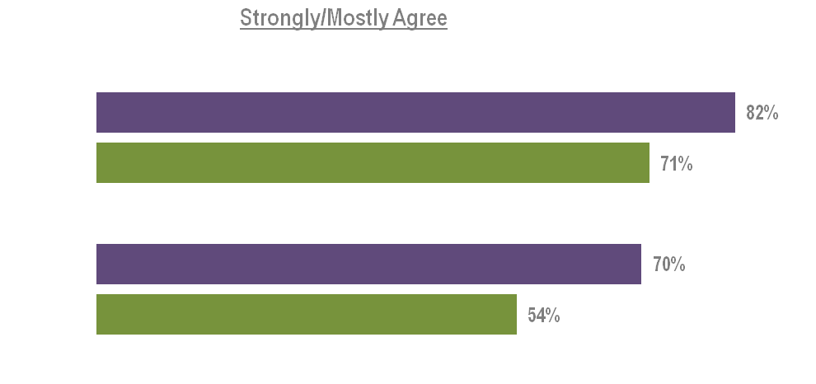
Perception Of Four-Year Institutions
Teachers and counselors may think that higher tuitions coupled with the economy and other “complexities” make a four-year college a less attractive alternative than before. They were also less likely to believe ALL high school students should continue with some postsecondary education than they did in 2006.
Please click on the response that most closely represents how much you agree or disagree with the statement. For each statement click on either strongly agree, mostly agree, somewhat agree, mostly disagree or strongly disagree.
(n)
All high school students should continue with some postsecondary education.
Then
(196)
Now
(306)
Although a typical four-year state college or university in Kentucky can cost a lot, it offers a value that is worth students going there all four years
Then
(196)
Now
(315)

Slide 9
Student Barriers To Higher Education
The greatest barrier to student pursuit of higher education was finances – just as it was in 2006. Tuition is too expensive, yet they don’t believe they will qualify for aid. Lack of personal motivation and family support also plays a role.
Thinking again generally about your students what would you say are the three largest barriers for your students to continue with their education?
%
Financial Costs/ Lack Financial Aid 79
- Tuition too expensive
- No Financial aid for people like them
- Can make money working/not in school
Lack of Personal Motivation/Focus 49
- No motivation/goals
- Fear of the “world out there”
- Unsure what to do
Lack Mentor/Support 43
- No Parental support
- Not a Family Value
Lack of Grades/School Orientation 18
- Not smart enough/not prepared
- Low ACT scores

Slide 10
Help For “At Risk” Students
Teachers and counselors admitted that they could/should do more to help the “At Risk” student, but emphasize that without some personal/familial support it will be a tough sell.
What practical steps need to be taken to assure that more “at risk” students are encouraged and supported to continue their education after high school?
%
High School Initiatives 53
- Push vocational/trade schools more
- Encourage them more
- Emphasize the importance more
- Do a better job teaching
Personal Attention/Mentors 48
- Parents need to be more involved
- Explain available opportunities
- Individualized attention/guidance
Postsecondary Initiatives 28
- Campus tours, visits
- Visits from school representatives
Financial Costs/Lack of Aid 20

Slide 11
Comparison: KCTCS And Four-Year Public Colleges & Universities
KCTCS colleges in their area were better at eliminating the barriers and the fears of their students about being overwhelmed or failing after high school. The smaller class sizes, campus layout and personal attention of the local community and technical college were credited with that.
In general, compared to a typical four-year public college or university in Kentucky, would you say the state’s local community and technical college in your area, does a better job, a worse job, or about the same job in helping students overcome the following barriers?
On Campus
(n)
Smaller classes to help overcome the barrier of feeling overwhelmed
Then
(182)
Now
3%
(299)
Campus layout that is easy to maneuver to help overcome the barrier of feeling overwhelmed
Then
2%
(176)
Now
2%
(296)
Personal attention to help with academic problems to overcome the fear of failure
Then
2%
(165)
Now
5%
(278)
The (n) indicates the number of respondents who were asked the question. Sample sizes for those who gave a response varied for individual items. Percents are based on those who gave a response to the statement.

Slide 12
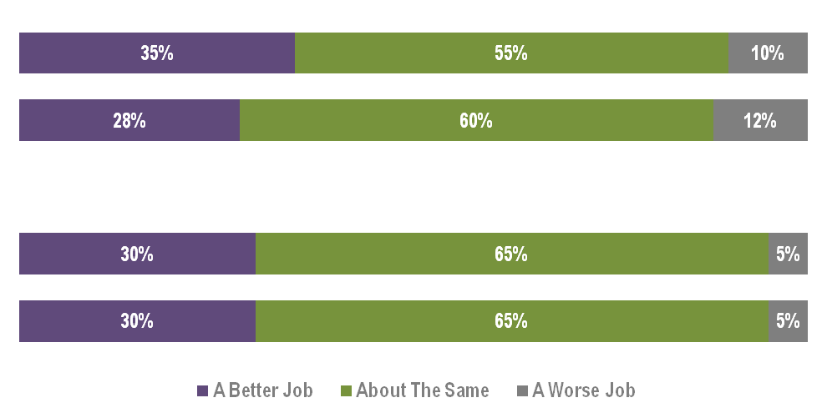
Comparison: KCTCS And Four-Year Public Colleges & Universities
Approximately a third of teachers and counselors felt KCTCS did a better job having scholarships and financial aid available compared to four-year public colleges.
In general, compared to a typical four-year public college or university in Kentucky, would you say the state’s local community and technical college in your area, does a better job, a worse job, or about the same job in helping students overcome the following barriers?
Affordability
(n)
Availability of scholarships to help overcome the barrier of affordability
Then
(170)
Now
(267)
Available financial aid to help overcome the barrier of affordability
Then
(172)
Now
(274)
The (n) indicates the number of respondents who were asked the question. Sample sizes for those who gave a response varied for individual items. Percents are based on those who gave a response to the statement.

Slide 13
Awareness and Image

Slide 14
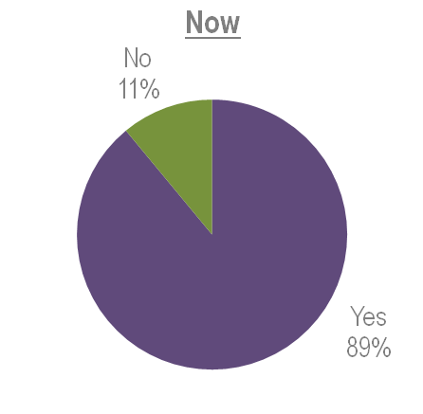
Awareness Of KCTCS as a “System”
As one might expect, most of Kentucky’s secondary school teachers and counselors were familiar with KCTCS as a system in 2006 and 2011.
We have been talking about the community and technical college that is closest to you. Were you aware that the college is a part of the larger state-wide Kentucky Community and Technical College System?
n = 196
n = 318

Slide 15
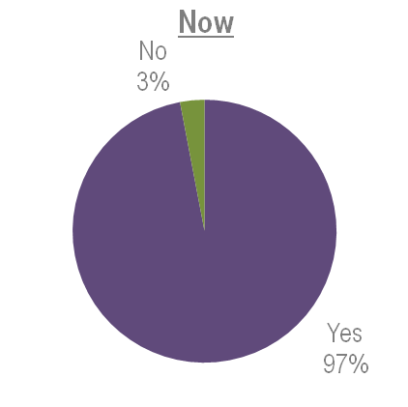
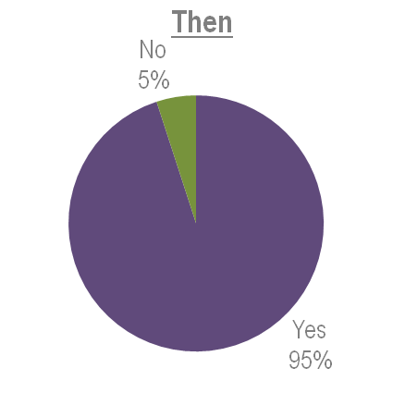
Awareness Of Closest KCTCS College
When it came to the KCTCS College closest to them, the awareness was near universal. So it was then, and it is now.
Now please think about the Kentucky Community and Technical College CLOSEST TO YOUR HIGH SCHOOL. Do you know the name of that college?
n = 196
n = 318

Slide 16
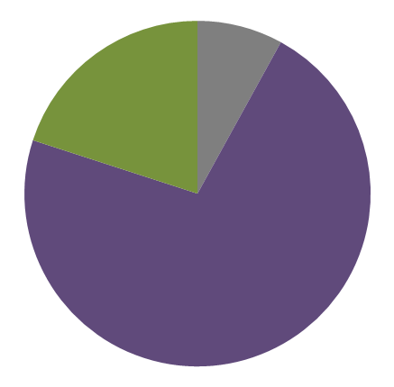
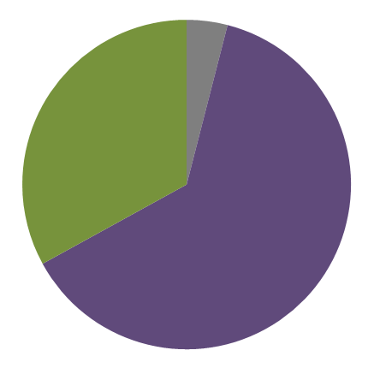
Overall Perception Of KCTCS as a “System“ Among Those Aware
Perceptions of KCTCS as a system have improved significantly since 2006.
What is your overall perception of the Kentucky Community and Technical College System (KCTCS)? Is it excellent, very good, good, fair or poor?
Then
Now
Fair/Poor
4%
Fair/Poor
8%
Good
20%
Good
33%
Excellent/Very Good
63%
Excellent/Very Good
72%
n = 174
n = 280

Slide 17
Most Significant Competitors*
The smaller (not UK or U of L) colleges that are less expensive (mostly state institutions) were considered by these teachers and counselors as the most significant competitors. More expensive private colleges and the larger universities were a distant second.
What universities, colleges or technical trade institutes do you believe are the most significant competitors that may also attract the attention of the students who might be considering your local Kentucky Community and Technical College?
Regional Kentucky Colleges and Universities 49%
- Eastern - Morehead
- Western - NKU
- Murray State - KY State
Private Colleges 22%
- Sullivan - Pikeville
- Spencerian - Berea
- St. Catherine - Campbellsville
Major Kentucky Universities 21%
- UK - U of L
Out-of-State Colleges 20%
- Cincinnati State
- Nashville Auto/Diesel
- Lincoln Memorial
* Listed colleges represent top responses in each category.

Slide 18
KCTCS Campus & Students
Just about everything about KCTCS campuses – their location, appearance, on-campus activities and welcoming attitude toward students of all types – were as good or maybe slightly better than last time according to these educators. However that openness and accessibility led a greater percentage of them to say the caliber of student was not as good as it was some years ago.
For the following questions please click on the answer that best describes how you would rate the closest Kentucky Community and Technical College in your area. Using either excellent, very good, good, fair or poor, how would you rate the KCTCS College in …?
 |  | Percent Excellent/Very Good
Campuses |  | Then (%) | Now (%)
Convenient Campus location |  | 65 | 78
The appearance of the Campus |  | 65 | 68
Outside of class “social college experience” |  | 24 | 34
Student Image
Being a good place for all types of students |  | 64 | 64
The overall image in the community |  | 56 | 60
The caliber of students |  | 50 | 39
n = |  | 196 | 318
The (n) indicates the number of respondents who were asked the question. Sample sizes for those who gave a response varied for individual items. Percents are based on those who gave a response to the statement.

Slide 19
KCTCS Accessibility
KCTCS Colleges were clearly seen by these teachers and counselors as doing much better at keeping the school affordable and offering scholarships than was the case in 2006. The ease of enrollment and the basic student aid was thought to be similar to years past.
For the following questions please click on the answer that best describes how you would rate the closest Kentucky Community and Technical College in your area. Using either excellent, very good, good, fair or poor, how would you rate the KCTCS College in …?
 |  | Percent Excellent/Very Good
Accessibility |  | Then (%) | Now (%)
Ease of Enrollment |  | 62 | 64
Providing Financial Aid to meet the needs of most students |  | 55 | 56
Affordability |  | 54 | 66
Scholarship Availability |  | 36 | 48
n = |  | 196 | 318
The (n) indicates the number of respondents who were asked the question. Sample sizes for those who gave a response varied for individual items. Percents are based on those who gave a response to the statement.

Slide 20
KCTCS Job Preparation & Academics
KCTCS Colleges continued to be viewed as good places to start with the eventual goal of getting a good job. Job placement was considered a little less successful but still half gave KCTCS positive marks in that regard. However, even though perceptions about academic program variety and reputation of the faculty remained the same, the overall academic reputation of the colleges declined discernibly since 2006.
For the following questions please click on the answer that best describes how you would rate the closest Kentucky Community and Technical College in your area. Using either excellent, very good, good, fair or poor, how would you rate the KCTCS College in …?
 |  | Percent Excellent/Very Good
Jobs |  | Then (%) | Now (%)
Being a good starting place to get a good job |  | 64 | 66
Placement of graduates in jobs after they have obtained degrees or certificates |  | 50 | 53
Academics
Its academic reputation |  | 58 | 48
Variety of academic programs |  | 56 | 57
The reputation of the faculty |  | 54 | 57
n = |  | 196 | 318
The (n) indicates the number of respondents who were asked the question. Sample sizes for those who gave a response varied for individual items. Percents are based on those who gave a response to the statement.

Slide 21
KCTCS Opportunities
KCTCS continued to get high marks as a place to “start” postsecondary education and then to continue it by offering good programs and credits toward a four-year degree and/or building skills for good employment opportunities.
Please click on the response that most closely represents how much you agree or disagree with the statement. For each statement click on either strongly agree, mostly agree, somewhat agree, mostly disagree or strongly disagree.
 |  | Percent Strongly/Mostly Agree
 |  | Then | Now
KCTCS offers good programs that help students improve their employment opportunities |  | 91% | 89%
KCTCS colleges are a good place to start by earning credits that transfer toward a 4-year degree |  | 79% | 82%
KCTCS colleges are a good place to get college experience while still in school |  | 79% | 82%
n = |  | 196 | 318
The (n) indicates the number of respondents who were asked the question. Sample sizes for those who gave a response varied for individual items. Percents are based on those who gave a response to the statement.

Slide 22
KCTCS Staff Responsiveness & Involvement
KCTCS staff – especially in the non-urban areas of the state have apparently “reached out” considerably to high school teachers and counselors – much more so than was the case five years ago. Their efforts to respond to requests and directly involve themselves in the school have been clearly recognized.
Again using the same scale of excellent, very good, good, fair or poor, please rate the same KCTCS college closest to you in their communication areas. First/next, how would you rate it in its …?
 |  | Percent Excellent/Very Good
 |  | Then (%) | Now (%)
Responsiveness to request for information |  | 57 | 67
Helpfulness of staff |  | 56 | 64
Involvement in the Community |  | 45 | 53
Frequency of contact with guidance counselors and/or teachers |  | 45 | 50
Involvement in your high school |  | 38 | 52
n = |  | 196 | 318
The (n) indicates the number of respondents who were asked the question. Sample sizes for those who gave a response varied for individual items. Percents are based on those who gave a response to the statement.

Slide 23
KCTCS Information & Communication
Information and communication between KCTCS Colleges and secondary school teachers and counselors has been phenomenal. The variety and attractiveness of publications as well as the website received dramatically higher evaluations than five years ago. Every difference was discernable and significant.
Again using the same scale of excellent, very good, good, fair or poor, please rate the same KCTCS college closest to you in their communication areas. First/next, how would you rate it in its …?
 |  | Percent Excellent/Very Good
 |  | Then (%) | Now (%)
Information provided at college fairs |  | 57 | 70
Attractiveness of publications including brochures and pamphlets |  | 48 | 60
Overall Website |  | 46 | 61
Variety of publications to meet the needs of students interested in different programs |  | 36 | 55
n = |  | 196 | 318
The (n) indicates the number of respondents who were asked the question. Sample sizes for those who gave a response varied for individual items. Percents are based on those who gave a response to the statement.

Slide 24
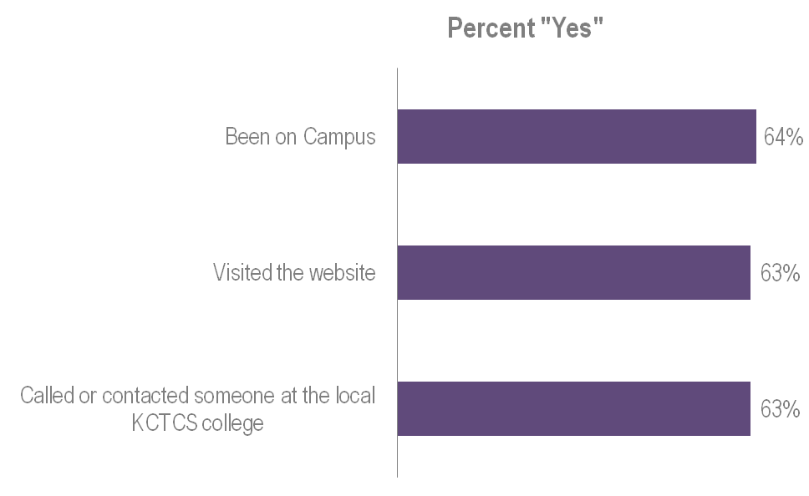
Behaviors With Closest KCTCS College
These Kentucky teachers and counselors were behaviorally engaged with the schools as well. Two out of three had connected on the web, by phone or on campus. They were clearly “working the system” on behalf of their students.
In the past two years, have you ever (___) the community and technical college closest to you?
n = 318

Slide 25
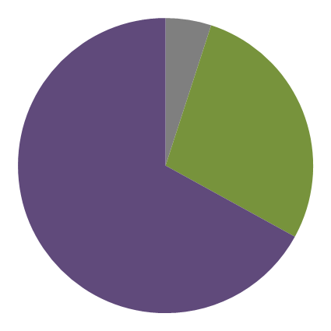
KCTCS As A “Start And Transfer From” Option
The brand promise that “higher education begins here” was reinforced by teachers and counselors most of whom felt KCTCS was an excellent way to start postsecondary education in a less intimidating, more affordable and convenient way.
Again, using excellent, very good, good, fair or poor, how would you rate the KCTCS college closest to you as a place to start college and then transfer credits to a four-year college or university in Kentucky?
Reasons
Fair/Poor
5%
Good Place to “Start” 36%
- Less Intimidating
- Time to adjust/mature
- Evaluate career path
Cost 35%
- More Affordable
- Live/work at home
- Financial Aid
Convenience 19%
- Close to home
- Class times
Transfer of Credits 13%
- Easy
- Dual credits in high school
Good
28%
Excellent/Very Good
67%
n = 301

Slide 26
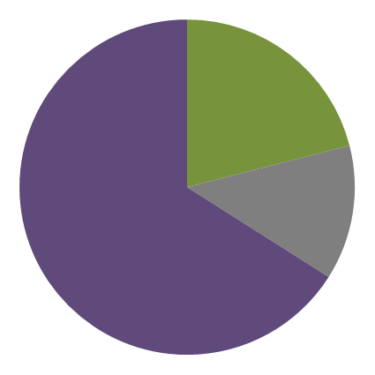
Ease Of Credit Transfer
The credit transfer process was seen as relatively easy to do. Only one in eight felt it was difficult. So teachers and counselors were already comfortable suggesting that their students pursue an associate’s degree, figuring it would be accepted when the time arrived.
Based on what you know or have heard is it (___) to transfer credits from the KCTCS college closest to you to a four-year college or university in Kentucky?
Very Easy
21%
Difficult/Very Difficult
13%
Easy
66%
n = 242

Slide 27
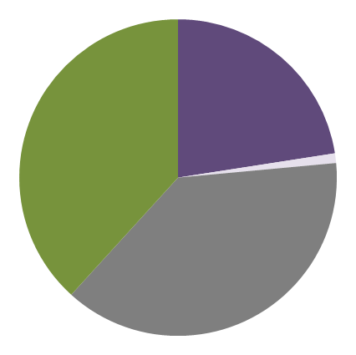
Ease Of Credit Transfer
The impact of the recent legislation to require state university acceptance of KCTCS credits had yet to make a major impression on these teachers and counselors. Only 23 percent thought it had gotten easier to transfer credits and only 28 percent of them attributed it to the new legislation.
To the best of your knowledge, over the past year has it become easier, about the same, or more difficult to get credits from the KCTCS college closest to you accepted at four-year colleges and universities in Kentucky?
Easier
23%
Top Reasons for Easier Transfer
Unsure
38%
New Legislation 28%
Efforts by KCTCS 28%
Seems Easier/Experience 18%
More Difficult
1%
n = 72
Same
39%
n = 318

Slide 28
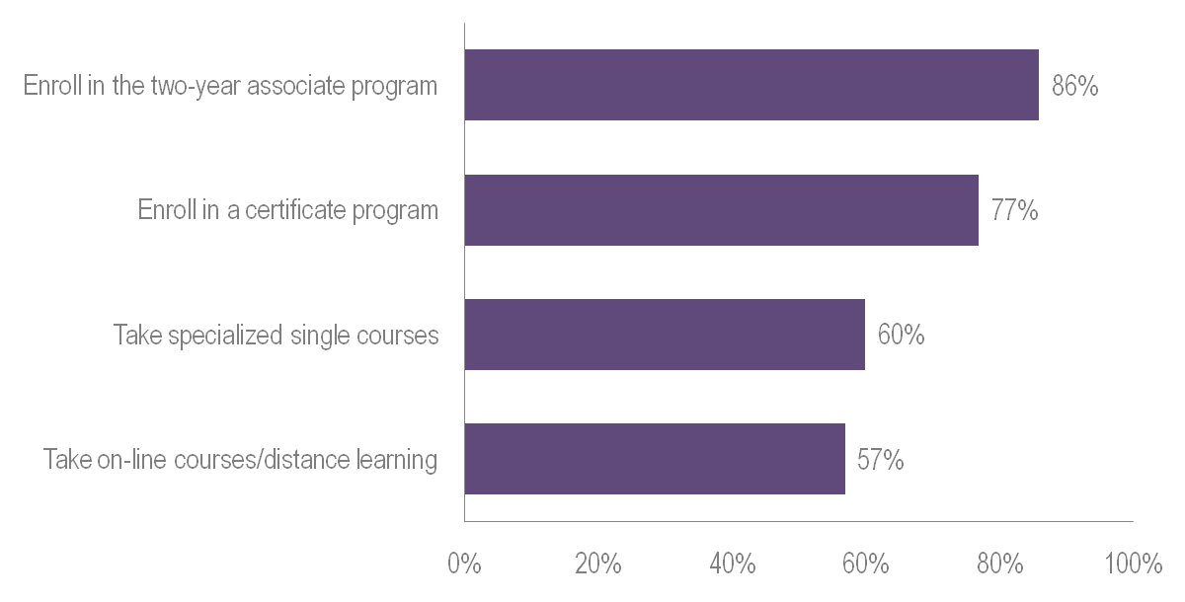
Recommended Usage Of KCTCS Opportunities
Kentucky teachers and counselors were clearly “selling” the KCTCS brand to their students. Four out of five had recommended that a student enroll in an associate program. The majority suggested other alternatives as well.
In the past several years have you ever recommended to a student that they (___) at a KCTCS college?

Slide 29
KCTCS Student Recommendation
KCTCS schools were mostly appreciated for what they can do for their students who might otherwise not consider school after high school or those looking for a technical field to excel in as a way to a better job. They also thought it would be a good fit for those struggling with academics or finances.
In the past several years, have you ever recommended that the following type of student seriously consider enrolling in a Kentucky Community and Technical college?
 |  | Percent “Yes”
 |  | Then (%) | Now (%)
A student interested in entering a technical field of employment |  | 94 | 94
A student who was otherwise not considering postsecondary education |  | 92 | 92
A student struggling with academics |  | 89 | 89
A student whose family you think is struggling financially |  | NA | 86
An honor student |  | 59 | 50
n = |  | (196) | (318)
The (n) indicates the number of respondents who were asked the question. Sample sizes for those who gave a response varied for individual items. Percents are based on those who gave a response to the statement.

