Slide 1
The Personal Information Session
Brian Dycus
July 2013

Slide 2
Agenda
Goal
Establish familiarity with building blocks of Intelliworks
Understand basic understanding of user features
Get you primed for future training and self-directed learning
Building Blocks
Contact Record • Lifecycle Stage • Interactions
User Features
Views • E-blasts • Activity Manager
Notes:
El to lead introductions and walk through agenda…

Slide 3
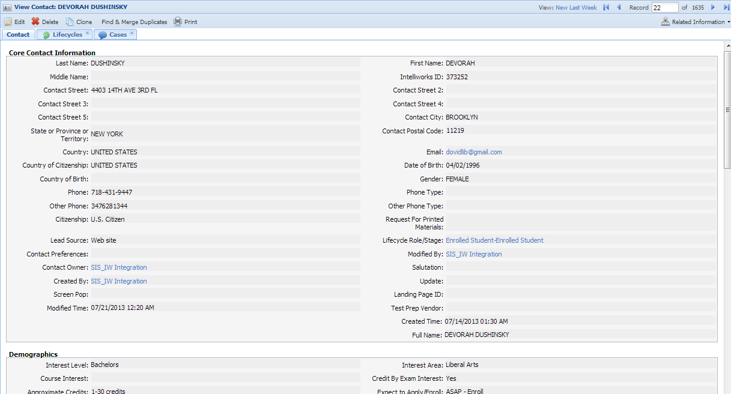
Contact Record

Slide 4
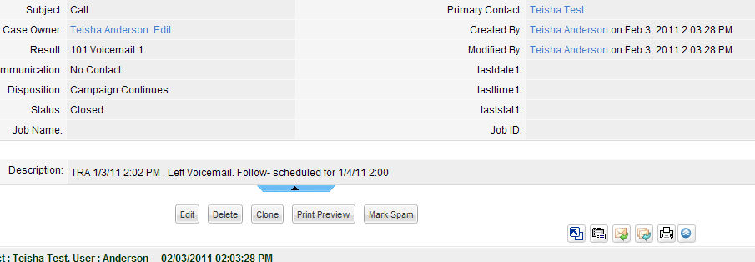
New Case Creation
Case Owner
Subject
Status

Slide 5
Case Records

Slide 6
Lifecycle Role/Stage Creation
Role / Stage
Primary Role
Modified Time

Slide 7
Lifecycle Roles/Stage Records

Slide 8
KCTCS Lifecycles
Role | Stage
New | Lead
Prospect | Attempted
Prospect | Engaged
Application | Unsubmitted
Application | Suspended
Application | Received
Student | Enrolled

Slide 9
Live View of IW
Intelliworks
Contacts
Cases
Lifecycle Stages

Slide 10
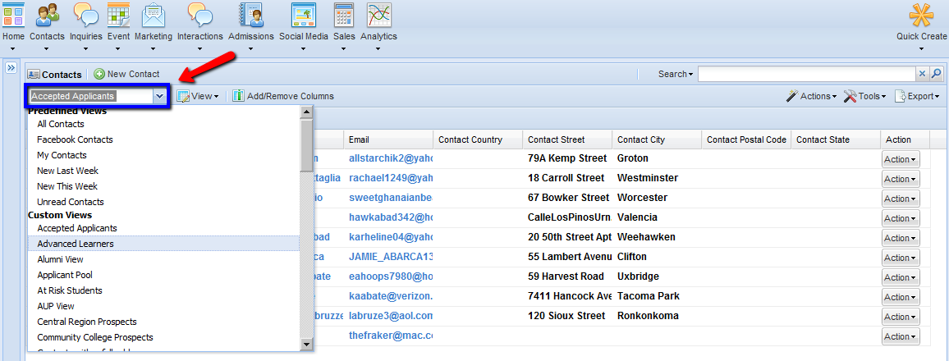
Views
Call lists
Email campaigns
Upcoming appointments

Slide 11
Live View of IW
Intelliworks
Date Range
Lifecycle Stage
Upcoming Tasks

Slide 12
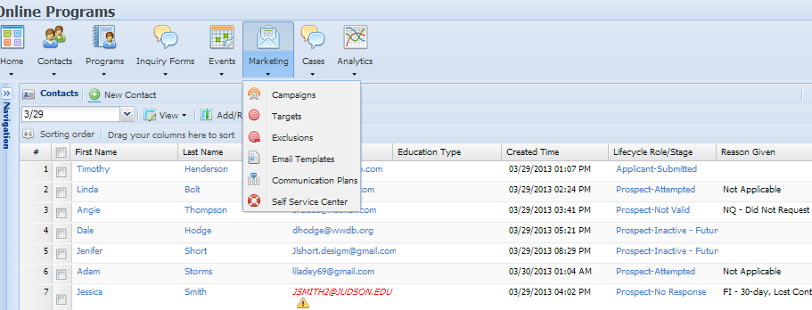
Email Campaigns

Slide 13
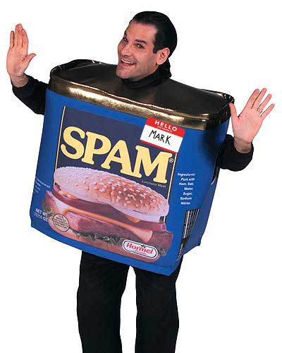
Live View of IW
Intelliworks
Email Template
Lead Targets
Campaign

Slide 14
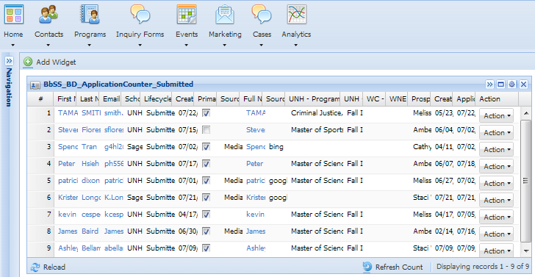
Widgets

Slide 15
Discussion & Next Steps

