Slide 1
The Personal Information Session
Brian Dycus
July 2013

Slide 2
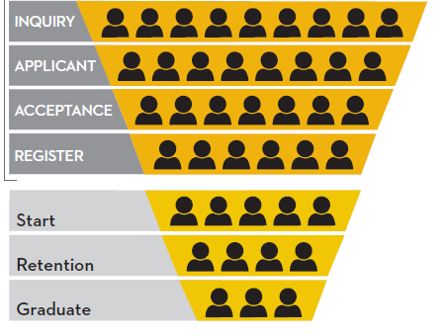
Agenda
Event Description
Purpose
Group Exercises
Discussion & Next Steps
Goal
Introduce a new tool for admissions officers
Promote your campus more effectively
Increase application rate
Notes:
El to lead introductions and walk through agenda…

Slide 3
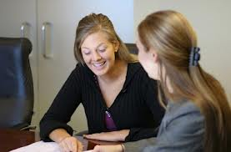
Personal Information Session
What?
Who?
Where?
When?
Why?
Lead
Information Gathering
Application

Slide 4
Unbalanced Recruiting Efforts
Lead Gathering
Advertising
Events
Prospecting
Mail
Calls
Lists
Concerns
Unsystematic Approach
Candidate Driven
Unstructured Information
Impersonal Approach

Slide 5
Personal Information Session
Lead Gathering
Advertising
Events
Prospecting
Mail
Calls
Lists
Advantages
Structured Information
Personalized Approach
Admissions Driven
Clear Admissions Step
Information Session

Slide 6
Personal Information Session
Agenda
Discover Candidate Profile
Establish Value Proposition
Identify Obstacles
Build Commitment
Clarify Next Steps
The ORDER matters
The PROFILE matters
The COMMITMENT matters
The MEDIUM doesn’t matter

Slide 7
Group Exercise – Your Proposition
Features
Obstacles
Faculty
Student Experience
Academic Support
Career Services
Course Schedules
Tuition

Slide 8
Group Exercise – Candidate Profiles
Traditional
Adult
Motivations
Needs / Obstacles
Relevant Features
Career
Education
Situation

Slide 9
Advantages
Clearer admissions process
Trackable steps
No “stealth applications”
Practice makes perfect
Considerations
Choosing your format
Time management decisions
Streamlining the tool

Slide 10
Discussion & Next Steps

